Slide 1
Malicious Messages Detector Based on Neural Network
Guodong SUN
Liang WANG
Supervisor: Jean-Philippe MONTEUUIS
SR2I 208.
Project of the Filière
24 June, 2019

Slide 2
Content
Introduction
Datasets -- Preprocessing
Neural Network based Detector
Abnormity Detector
Attack Classifier
Proof of Concept
Conclusion
2

Slide 3
Introduction
3

Slide 4
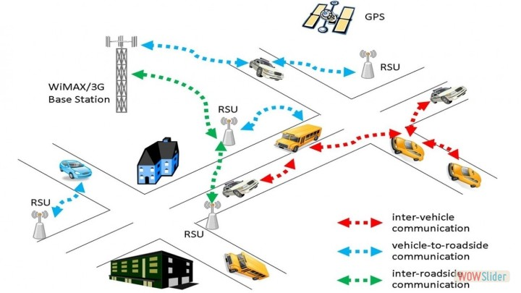
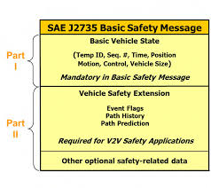
Background
VANET
Data type:
BSM
4

Slide 5
Type of Attackers
-Constant : Attacker report a false position which is a constant value.
-Constant Offset : Attacker transmits a fixed offset added to the real position.
-Random : Attacker sends a random position inside the simulation area.
-Random Offset : Attacker sends a random position within a rectangle around the vehicle.
-Eventual Stop : Attackers behave normally for some time and then attacks by transmitting the same position repeatedly.

Slide 6
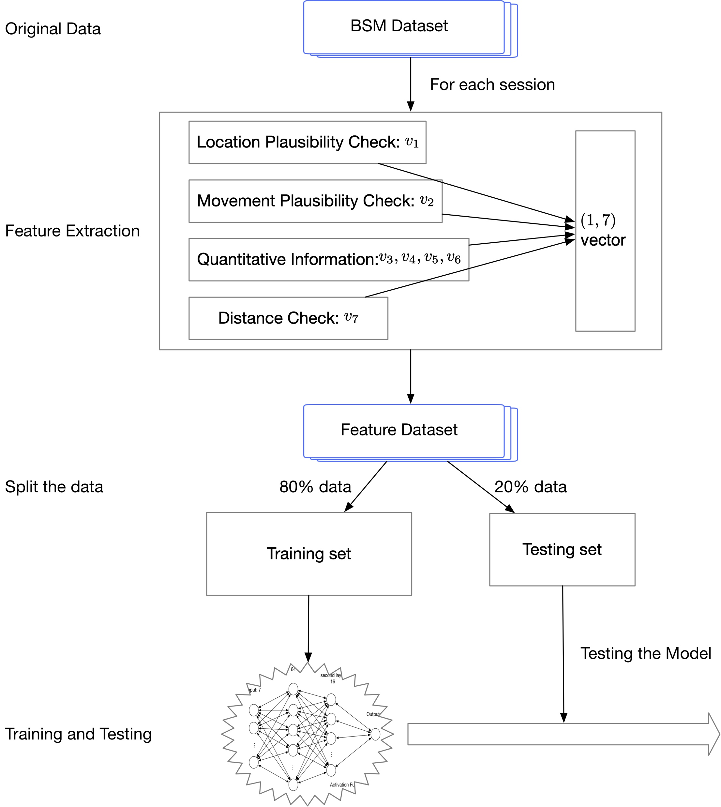
Step 1
Step 2
Work Flow
(for both models)
Step 3
Step 4

Slide 7
Datasets -- Preprocessing
7

Slide 8
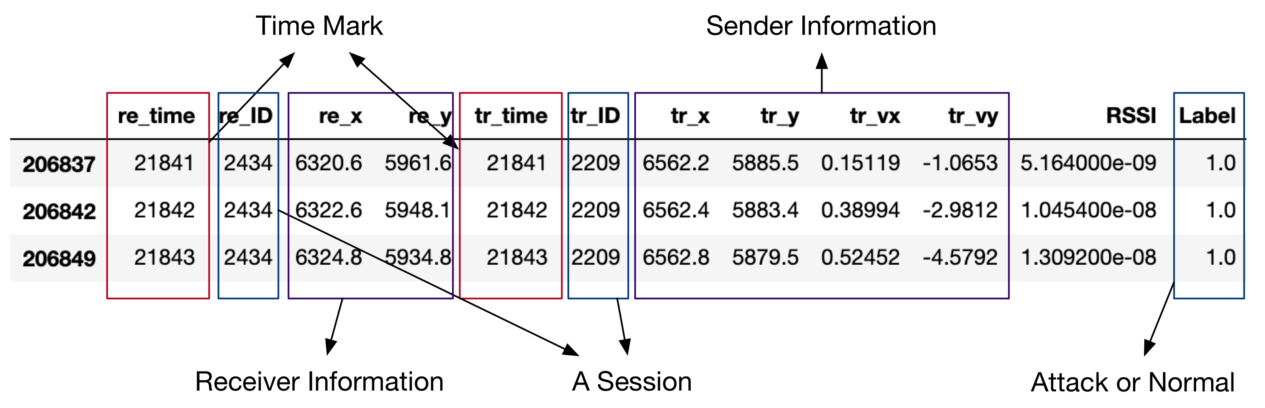
A BSM
A communication session between a sender and a receiver.
A session is whether ‘Normal’ or ‘Attack’.
Fig: a typical session
8

Slide 9
Columns of dataset
Type (3=BSM)
Time BSM was received by the receiver
Receiver ID
Receiver X position
Receiver Y position
Receiver Z position
Time BSM was transmitted
Sender ID
BSM ID
Sender X position
Sender Y position
Sender Z position
Sender X velocity
Sender Y velocity
Sender Z velocity
RSSI of received signal
Label (0=Normal Behavior)

Slide 10
Statistics of Dataset
There are five datasets, each consists of a type of attacks and normal data.
Our first mission is to identify the abnormity from each dataset.
Table: statistics of the datasets
 | # Rows | # Sessions | # Attack | # Normal
Type 1 | 387516 | 30588 | 0.3143 | 0.6857
Type 2 | 387516 | 30588 | 0.3143 | 0.6857
Type 4 | 387634 | 30642 | 0.3449 | 0.6551
Type 8 | 386747 | 30596 | 0.2551 | 0.7449
Type 16 | 386834 | 30601 | 0.2964 | 0.7036
[1] R. W. van der Heijden, T. Lukaseder, and F. Kargl, “VeReMi: A Dataset for Comparable Evaluation of Misbehavior
Detection in VANETs,” in Security and Privacy in Communication Networks, vol. 254, no. 2, Cham: Springer, Cham, 2018,
pp. 318–337.
10

Slide 11
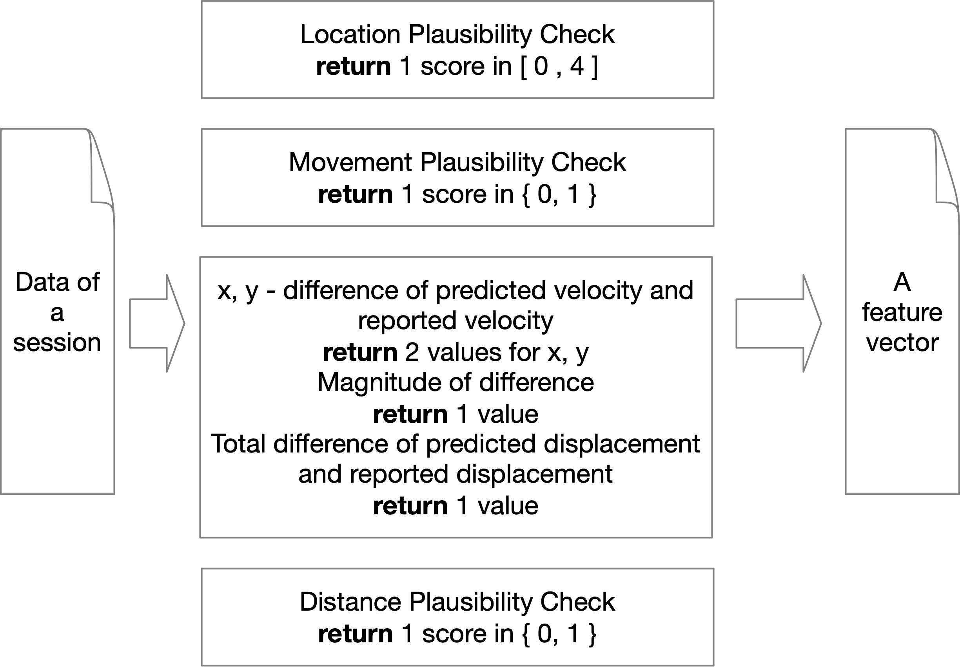
Obtaining
Feature vectors
11

Slide 12
Splitting the datasets
We split the datasets into two parts: 80% for training and 20% for testing
Table: Statistics of split data (feature vector) set.
 | Sessions | Training datasets |  | Testing datasets
 |  | Attack | Normal | Attack | Normal
Type 1 | 30588 | 0.3122 | 0.6877 | 0.3228 | 0.6771
Type 2 | 30588 | 0.3142 | 0.6857 | 0.3146 | 0.6853
Type 4 | 30642 | 0.3456 | 0.6543 | 0.3414 | 0.6585
Type 8 | 30596 | 0.2582 | 0.7417 | 0.2424 | 0.7575
Type 16 | 30601 | 0.2982 | 0.7017 | 0.2888 | 0.7111
All data | 153015 | 0.3047 | 0.6952 | 0.3060 | 0.6939
12

Slide 13
Neural Network based Detector
13

Slide 14
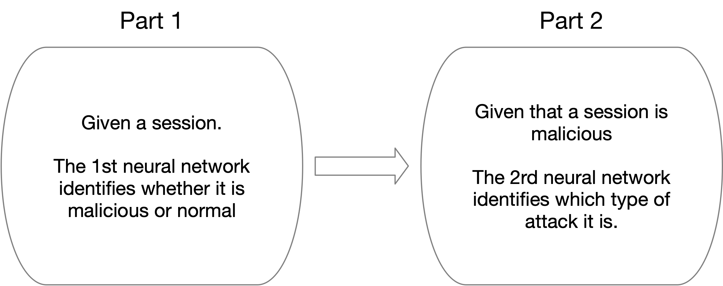
Our Neural Network Model

Slide 15
Part 1: Abnormity Detector
15

Slide 16
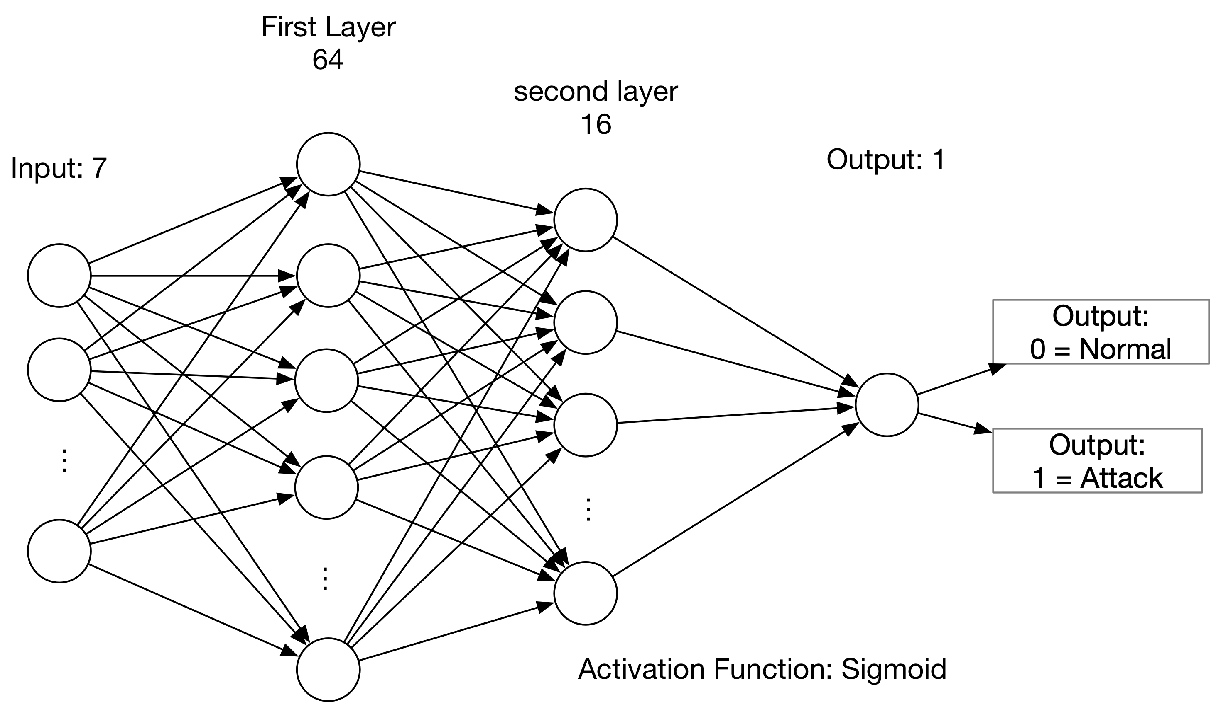
Fig: structure of neural network based detector.
Detector Model
Loss function: Mean_Absolute_Error
Optimizer: RMSprop
16

Slide 17
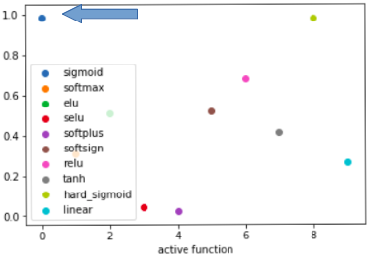
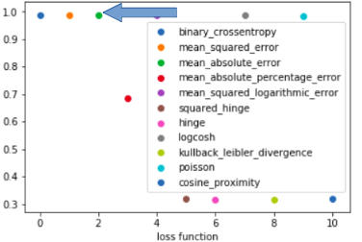
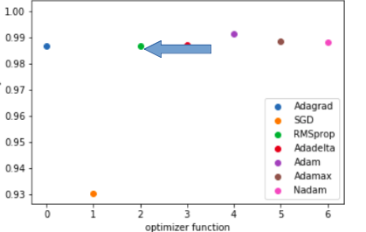
Choice of parameters
According to the experiment, we find best parameters according to the accuracy metric for:
Active function parameter
Loss function parameter
Optimizer function parameter

Slide 18
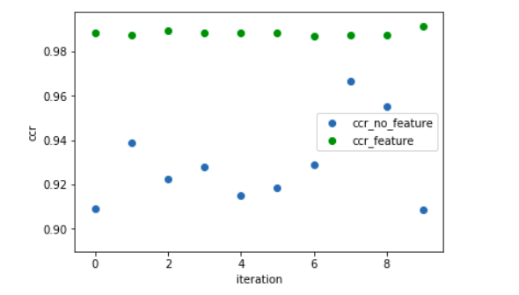
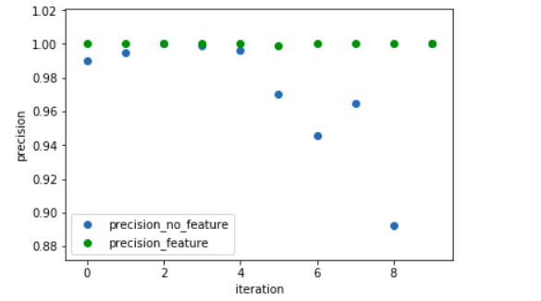
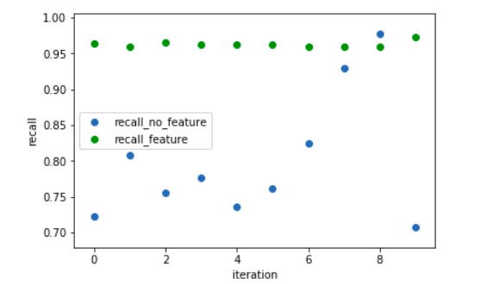
Feature Evaluation
Performance of dataset with feature and original dataset with no feature
18

Slide 19
Experimental Results
Table: performance comparison of attack detection per method
 | attack 1 |  |  | attack 2*** |  |  | attack 4 |  |  | attack 8 |  |  | attack 16
 | SVM[2] | KNN[2] | Neural Net | SVM [2] | KNN [2] | Neural Net | SVM [2] | KNN [2] | Neural Net | SVM [2] | KNN [2] | Neural Net | SVM [2] | KNN [2] | Neural Net
CCR | 0.9452 | 0.9564 | 0.9907 | 0.7508 | 0.7543 | 0.6854 | 0.9463 | 0.9116 | 0.9825 | 0.9471 | 0.9177 | 0.9725 | 0.8173 | 0.8403 | 0.9647
Precision | 0.9521 | 1.000 | 1.0 | 0.5613 | 0.5729 | 0.0 | 0.9506 | 0.8149 | 0.9990 | 0.9627 | 0.8035 | 0.9955 | 0.7143 | 0.8162 | 0.985
Recall | 0.8328 | 0.8290 | 0.9702 | 0.1937 | 0.1788 | 0.0 | 0.8363 | 0.8860 | 0.9498 | 0.8253 | 0.8755 | 0.8908 | 0.4254 | 0.4636 | 0.891
*** Note that Neural network based
model could not detect attack 2
CCR: Correct Categorical Rate.
[2] S. So, P. Sharma, and J. Petit, “Integrating Plausibility Checks and Machine Learning for Misbehavior Detection in
VANET,” presented at the 2018 17th IEEE International Conference on Machine Learning and Applications (ICMLA), pp. 564–571.
19

Slide 20
Experimental Results
Table: performance comparison of the overall attack detection
 | SVM | KNN | Neural Net
CCR | 0.8788 | 0.8838 | 0.9244
Precision | 0.8879 | 0.8716 | 0.9948
Recall | 0.6166 | 0.6515 | 0.7868
20

Slide 21
Part 2, Attack Classification
21

Slide 22
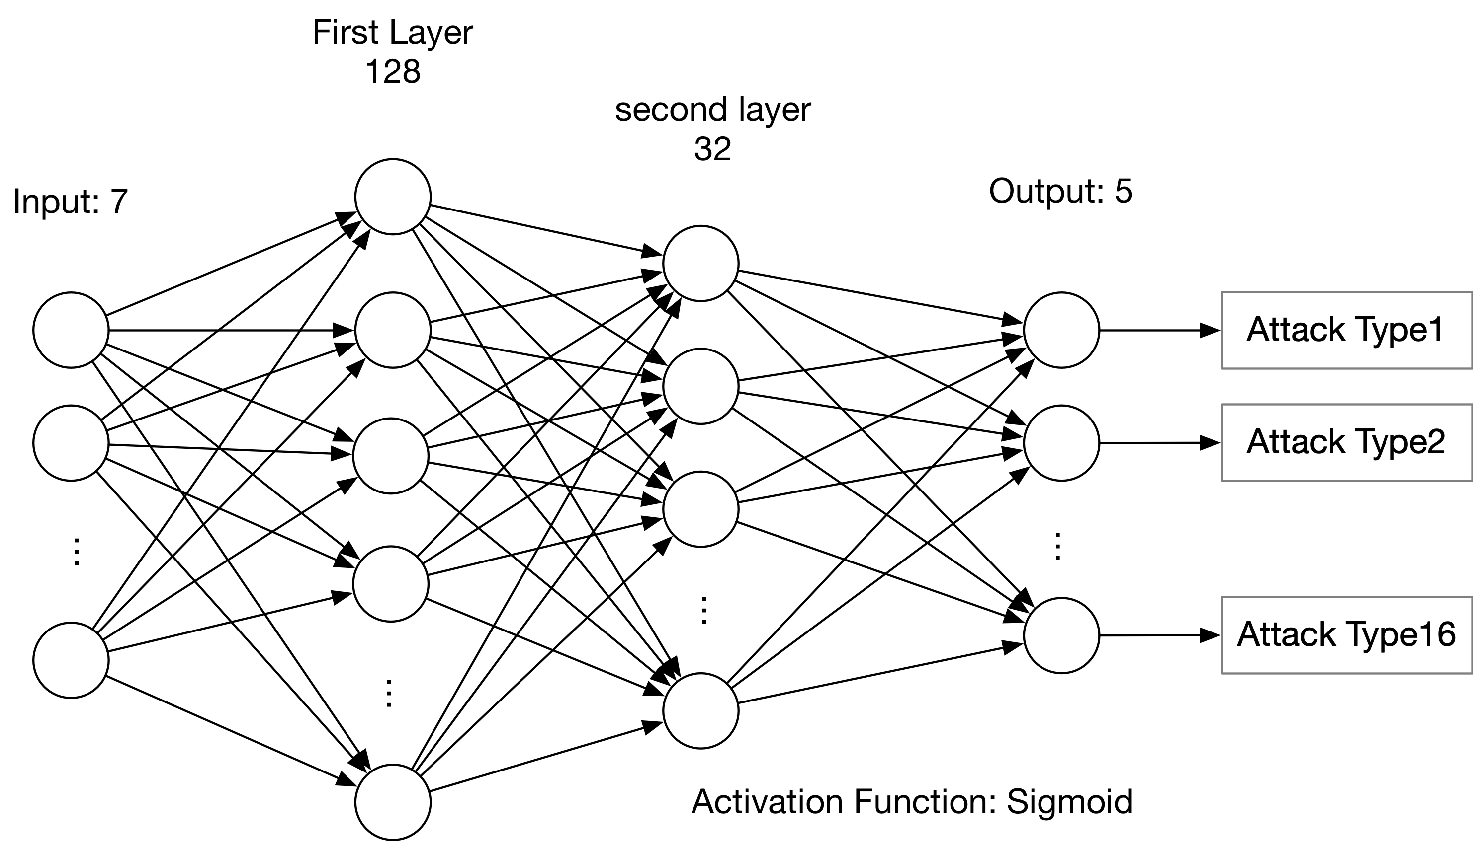
Fig: structure of neural network based classifier.
Classification Model
22

Slide 23
Classification Results
Table: results of classification accuracy
 |  | Prediction
 |  | Type 1 | Type 2*** | Type 4 | Type 8 | Type 16
Ground truth | Type 1 | 0.7623 | 0.0212 | 0.0779 | 0.0191 | 0.1145
 | Type 2 | 0.0016 | 0.9401 | 0.0096 | 0.0444 | 0.0043
 | Type 4 | 0.0005 | 0 | 0.9909 | 0.0068 | 0.0018
 | Type 8 | 0 | 0.0458 | 0.0040 | 0.9259 | 0.0243
 | Type 16 | 0.2707 | 0.0620 | 0.0344 | 0.0450 | 0.5879
***Note that it is invalid for Type 2 attacker, because the first step, i.e. identifying whether the session
is malicious or does not success.
23

Slide 24
Proof of Concept
24

Slide 25
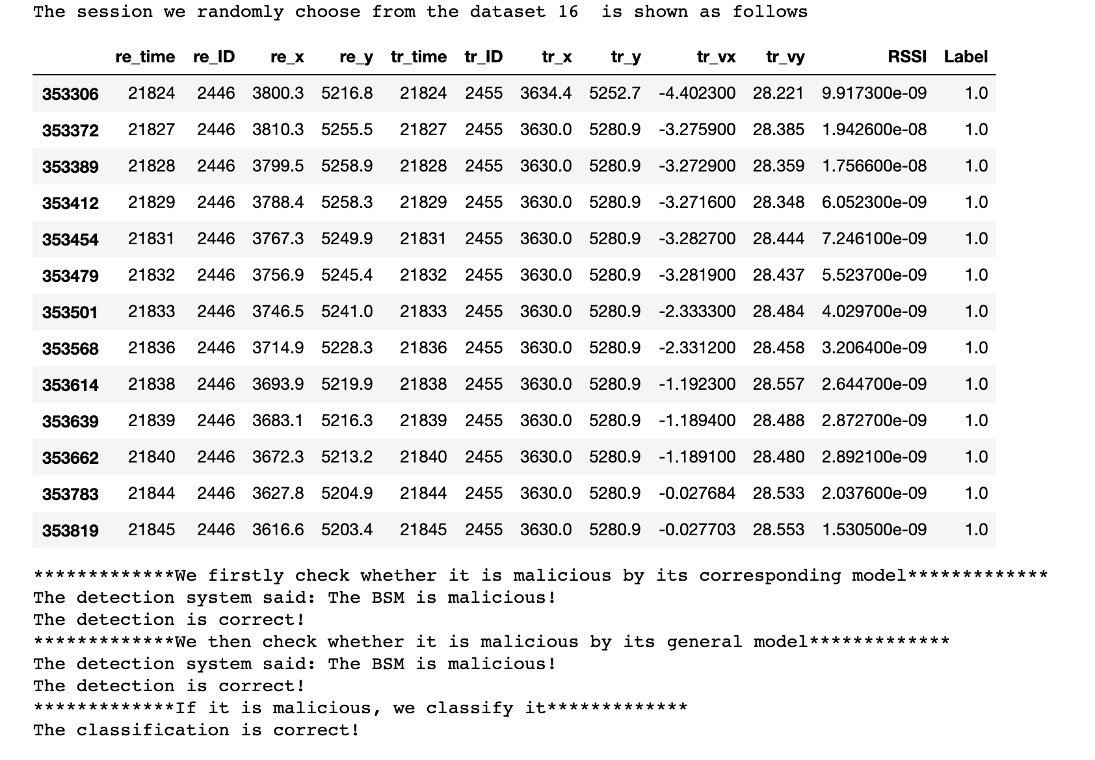
Proof of
Concept
25

Slide 26
Conclusion
26

Slide 27
Conclusion
“Constant offset” attack could not be detected by the proposed model.
Investigate messages correlation in the future.
NN based detector performs better than State of the Art.
27

Slide 28
Thanks!
28

